Slide 1
ATM Banking Management System
Shivam Saxena

Slide 2
Modules
Help Menu
Cash Withdrawal
Cash Deposit
Balance Enquiry
Mini Statement
Pin Change
Loan Information

Slide 3
What is the use of this application
This application “ATM Banking Management System” is used to
1. Easy to operate an ATM
2. No employee needed to manage an ATM.
3. Safe and Secure.
4. Access from anywhere and Real time updates.

Slide 4
Login
Login screen: Enter account no. and password. If you enter correct password you can proceed further. Press “sign in” to proceed. Press “sign up” if you are not a registered user.
Registration screen: To get registered we have to fill and details and if you have a registered account then you can go back to the login screen.
Registration screen: When we fill the details the account number will be auto-generated.

Slide 5
Transaction menu
Select any one option from the following:
1) Cash Withdrawal 4) Pin Change
2) Balance Enquiry 5) Cash Deposit
3) Mini Statement 6) Loan Information
→Help
→Cancel

Slide 6
Cash Withdrawal and Depsit
Cash withdrawal screen: Enter the amount to withdrawal and press “enter”. If you want to clear the amount withdrawal press “clear” and if you want to go back to the back-screen press “cancel”.
Cash deposit screen: Enter the amount to be deposit and press “enter”. If you want to clear the amount deposit press “clear” and if you want to go back to the back-screen press “cancel”.

Slide 7
Balance Enquiry and Mini Statement
Balance Enquiry screen: Total balance will be displayed in a dialog box.
Mini Statement screen: In mini statement screen the last transaction will be shown like deposit and withdrawal amount

Slide 8
Pin Change
Pin Change screen: Enter new pin no. and confirm new pin no. to change the pin. After filling press “enter” to change. If you want to clear the pin entered press “clear”. You can also go back to the transaction menu if you don’t want to change the pin no.
A window will pop up to confirm if the pins are matching or not.

Slide 9
Loan Information
Loan Information: If you press “apply” all the necessary details will be displayed i.e. Required documents and Interest rates on each kind of loans.

Slide 10
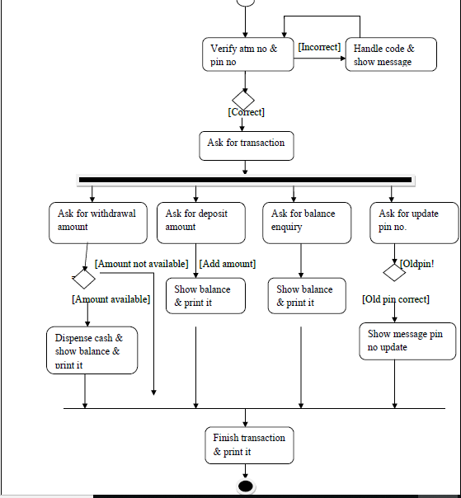
Activity Diagram

Slide 11
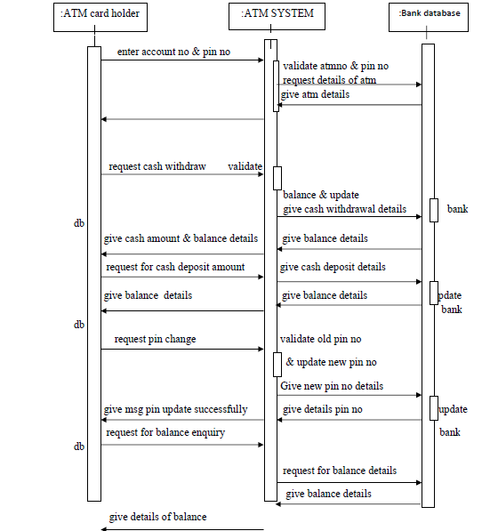
Sequence Diagram

Slide 12
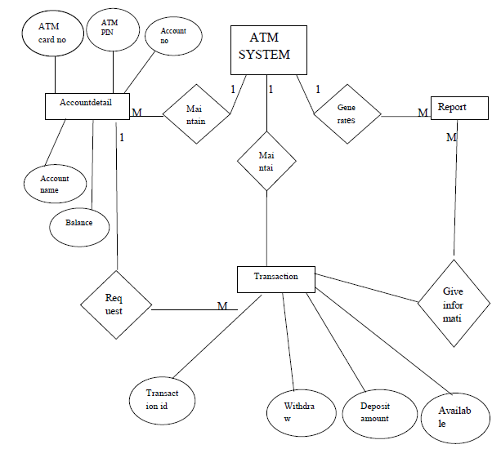
ER Diagram

Slide 13
Login

Slide 14
Registration

Slide 15
Cash Withdrawal

Slide 16
Cash Deposit

Slide 18
Pin Change

Slide 19
Mini Statement

Slide 20
Loan Information

Slide 21
Help Screen

Slide 22
Database Tables

Slide 23
Database Tables

Slide 24
THANK YOU!
Shivam Saxena
(40721102017)

